Slide 1
Intro. To HTML and CSS
J. Verlin
Computer Science
September 7 – November 9, 2017

Slide 2
Do Now #1: September 7, 2017
Open a web browser and browse out to http://www.google.com. Log in with your Google account. Find the ”Sites” icon within the app selector and click on it.

Slide 3
Do Now #2: September 7, 2017
Register for a Khan Academy account by doing the following:
Browse http://www.khanacademy.org and create an account.
Browse http://www.khanacademy.org/coaches.
In the “Add a coach” field, enter “QZHBHE” for “A” day or “PK87YZ” for “B” day.

Slide 4
September 7, 2017: Basic HTML Tags
Objectives: (1.) the students will be able to create an “About Me” page using Google sites and (2.) define what HTML is and how to use at least 5 basic tags in order to create a web page containing 5 2-line poems.
Direct Instruction: <html>, <title>, <body>, <h1> and <p> tags.
Guided Practice: “Write a Poem” challenge in Khan Academy
Cooperative Practice: in pairs, create your own poems from scratch. It must be at least 5 lines and use at least 1 pair of each of the tags you learned today. Save the file as an HTML file when finished and open it in a web browser (30 classwork points).

Slide 5
Homework: due Sept. 8
Write another 5-line poem as you did in class today and save it as an HTML file. During the Do Now for next class, you will open these in a browser as I inspect your homework (10 homework points).

Slide 6
Do Now: September 8, 2017
Open the html file you created for homework in a browser. I will inspect.

Slide 7
Do Now: September 11-12, 2017
Quiz: on the slips provided, write your name, today’s date and correct the error in the following code snippet so that the lines will print to the screen: (10 classwork points):
<h1> My Resume
5898 Lancaster Avenue </p>

Slide 8
September 11-12, 2017: Text Emphasis
Objective: the students will be able to use the <strong> and <em> tags to boldface and italicize text in order to draft a resume.
Direct Instruction: boldfacing <strong>, italicizing <em>, bullets <ul> and numbered lists <li>
Guided Practice: “...you can learn…” challenge
Cooperative Practice: open Notepad and type “This is bold text and this is italics.” Use the appropriate tags to boldface the word “boldface” in the sentence and italicize “italics”. Save the file on the desktop using the html extension and open it in a browser to verify the formatting.

Slide 9
Homework: due September 18, 2017
In a text file, type a list of any 5 items. Apply the appropriate markup tags so that the items appear as a bulleted list when opened in a web browser. Save it as an HTML file on a flash drive or in your Google Drive account. During tomorrow’s Do Now, I will ask you to open these files in a browser so that I can inspect (10 homework points).

Slide 10
Do Now: September 13-14, 2017
Browse out to http://www.jverlin.com.
Click on the “My CV” link.
Highlight the entire resume.
Right click and select the Copy command.
Create a new page on your Google site “My Resume”
Right click on the page and select the Paste command.

Slide 11
September 13-18, 2017: Resumes
Objective: the students will be able to write a resume in order to establish a presence on the internet.
Direct Instruction: templates and formatting
Independent Practice: edit the resume to suit your needs (30 classwork points)
Take out the sections which don’t apply.
Change those that do as appropriate.

Slide 12
September 13 and 18, 2017: Images and Lists
Objective: the students will be able to insert images in HTML documents in order to create a web page.
Direct Instruction: titles, image sources (<img> tags) and attributes
Guided Practice: creating a page with an image (250x250) and a bulleted list
Independent Practice: load the resume page with the title at the top which you created in class last week. Use the <br> tag to create 3 line breaks immediately after the zip code in the title. Create the first major heading “EDUCATION:” in boldface type. Then create a 2 or 3-item bulleted list containing the elementary, middle and high schools you attended along with date ranges in parenthesis. Finally, add an image from the image library 250x250 pixels.

Slide 13
Do Now: September 19, 2017
Open the 5-item bullet list you did for homework in a web browser. Also copy the following tags to your notebooks and leave 2 spaces between each:
<!DOCTYPE html>
<html> </html>
<head> </head>
<body> </body>
<h1>...</h6>
<p> </p>
<br>
<ol> </ol>
<ul> </ul>
<li> </li>
<title> </title>
<img src>
<height>
<width>

Slide 14
Do Now: September 19 and 20, 2017
Log into Khan Academy and on a scrap sheet of paper, list 3 of your favorite cities.
For our next project, we will create an HTML page consisting of a travel itinerary to those cities. Project requirements will be explained shortly.

Slide 15
September 19 and 20, 2017: HTML Page Project
Objective: the students will be able to insert images in HTML documents in order to create a web page of a travel itinerary.
Project Requirements:
Page title using the <h1> tag
3 images of your favorite cities (250 pixels x 250 pixels each)
Titles for each city using the <h3> tag
1 bulleted list containing at least 2 geographical facts
1 ordered list containing at least 2 places of interest
1 3-sentence paragraph describing why these cities are great places to visit.
Due Date: end of class September 20 (30 project points)

Slide 16
Do Now: September 25 and 26, 2017
Make a list of months September through June. Next to each month, write your favorite movie.

Slide 17
September 25 and 26, 2017: Links
Objective: the students will be able to create 10 links to absolute U.R.L.s in a web page in order to create a film festival calendar.
Direct Instruction: <a></a> tags and http… references within lists.
Guided Practice: “...links you love” challenge on K.A.
Cooperative Practice: in pairs or groups of 3 (max.), create a film-of-the-month page to display a favorite film each month for 10 months. Each month must include a heading using the <h1> tag, the month names beneath using the <h3> tag, the film name using the <p> tag linked to an absolute U.R.L. using the <a> tag and a 3-sentence review using the <p> and <br> tags (30 classwork points).

Slide 18
Do Now: September 27, 2017
Write the following terms in your notebooks and leave at least 1 line between each for definitions: row, column and table.

Slide 19
Do Now: September 28, 2017
Quiz: on the slips provided, write your name, today’s date and the purpose of the following tags (3 quiz points):
<th>
<tr>
<td>

Slide 20
September 27 and 28, 2016: Tables
Objective: the students will be able to add a table of at least 5 columns by 6 rows to a web page in order to create a web page equivalent of their class rosters.
Direct Instruction: <table>, </table>, <thead>, </thead>, <tbody>, </tbody>, <th>, </th>, <tr>, </tr>, <td>, </td> and <hr>.
Guided Practice: “Dinner Menu” challenge on Khan Academy
Independent Practice: transform your roster sketch in the Do Now to a table in a blank web page (30 classwork points).

Slide 21
Do Now: September 29, 2017
Log on to http://www.khanacademy.org and click on the link titled “Project: Recipe book” located within the “Intro HTML/CSS…” class beneath the “More HTML tags” section.

Slide 22
September 29 - October 4, 2017: Recipe Book
Project Requirements (50 project points, due Oct. 4):
5 recipes
Table of contents with links to jump to the recipe below
An attractively formatted recipe title (<h1> at the top)
At least 1 attractively formatted graphic illustrating each finished product
A 2-item bulleted list containing preparation time (mins.) and serving quantity
A 2-row table for each recipe with cols. for ingredients and quan. of each
Procedure steps for each using <p> and <br> tags (see sample)
A source (italics)

Slide 23
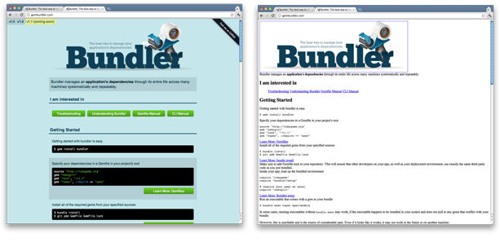
Do Now: October 5 & 6, 2017
Examine the following images and list at least 3 reasons why one is visually more appealing.

Slide 24
October 5 & 6, 2017: Tag Selection
Objective: the students will be able to add an image, change the background color and text colors in order to be able to create a colorful creature.
Direct Instruction: background and text color changes
Guided Practice: “Colorful Creature” challenge (first 2 steps)
Independent Practice: Finish the “Colorful Creature” challenge. Then in a blank web page, write a 5-line poem. Change the background color and employ at least 3 text colors. Allow me to inspect. Then copy your code and paste it in a Notebook file. Save it as a *.html file. I will show you how to view it directly in a web browser (60 classwork points).

Slide 25
Do Now: October 9-10, 2017
Explain what it means to be a member of a “class” of people (1 sentence max.). How would you feel if rules were made to affect only a class of people? Do you believe that these types of rules can sometimes be justified?

Slide 26
October 9 & 10, 2017: Classes and Class Operators
Objective: the students will be able to affect selective color changes to text in order to create a colorful menu.
Direct Instruction: classes and class operators
Guided Practice: the “Apples and bananas” challenge
Cooperative Practice: write a JavaScript which (1) places 7 lines of text on the screen and (2) add 7 classes to color only the last word of each line the following colors: red, orange, yellow, green, blue, indigo and violet (30 classwork points).

Slide 27
Do Now: October 11 and 12, 2017
Write 1 sentence defining what a font is.

Slide 28
Do Now: October 13 and 17, 2017
Load the travel itinerary projects you began during the previous class for inspection.

Slide 29
October 11-17, 2017: C.S.S. Project
Objective: the students will be able to add a colored background, a font family method to their C.S.S. in order to enhance the appearance of their travel itinerary projects.
Direct Instruction: colored backgrounds, font families and paragraph classes
Independent Practice: enhance the travel itinerary projects from earlier last month by implementing a layout table similar to the teacher’s ”…Curacao” project at https://www.khanacademy.org/computer-programming/spin-off-of-caribbean-travel-curaao/5471788675. The page must have a background image and at least 3 paragraph classes of the same font family. Bonus: for added effect, make each paragraph a different color. Due by the end of class on Oct. 16 (50 project points).

Slide 30
Do Now: October 18, 2017
Write 1 sentence defining what a font is.

Slide 31
Do Now: October 19, 2017
Name at least 2 properties of fonts (e.g.: size).

Slide 32
October 18 and 19, 2017: Font and Table Properties
Objective: the students will be able to change the font families, styles and sizes on a web page in order to create a blog.
Direct Instruction (Oct. 18): Font Properties
Font Family
Color
Font Size
Direct Instruction (Oct. 19): Table Properties
Comments
Borders
Alignment
Height and Width

Slide 33
October 18, 2017: Font Sizes
Objective: the students will be able to change the font families, styles and sizes on a web page in order to create a blog.
Direct Instruction: Font Sizes
Guided Practice: “Great big font sizes” challenge
Independent Practice: Fancy 5-line Poems (30 classwork points)
Add 2 more lines to your 5-line poems.
Make each line a different color
Write a CSS rule where the “fantasy” font family applies for all 7 lines.
Make each line an increasingly greater size.

Slide 34
October 19, 2017: Font and Table Properties
Objective: the students will be able to change the font families, styles and sizes on a web page in order to create a blog.
Independent Practice (30 classwork points):
Load your travel itinerary or recipe book project from earlier last month.
Make the following modifications:
Write a C.S.S. rule formatting your tables with borders.
Write a C.S.S. rule aligning the text in the header row to “center.”
Write a C.S.S. rule aligning the data in the table to “left.”

Slide 35
Do Now: October 20 and 23, 2017
List at least 3 parts of a blog and define what the overall function of a blog is.

Slide 36
October 20 and 23, 2017: Font Styles
Objective: the students will be able to change the font families, styles and sizes on a web page in order to create a blog.
Direct Instruction: Font Styles
font-weight
font-italic
Guided Practice: “Famous font formats” challenge
Independent Practice: Fancy 7-line Poems (30 classwork points)
Add a title.
Make the title bold using the font-weight property.
Italicize each line using the font-style property.

Slide 37
Do Now: October 24 and 25, 2017
List at least 3 parts of a blog and define what the overall function of a blog is.

Slide 38
October 24 and 25, 2017: Font Styles
Objective: the students will be able to change the font families, styles and sizes on a web page in order to create a blog.
Direct Instruction: Font Styles
font-weight
font-italic
Guided Practice: “Famous font formats” challenge
Independent Practice: Fancy 7-line Poems (30 classwork points)
Add a title.
Make the title bold using the font-weight property.
Italicize each line using the font-style property.

Slide 39
Do Now: October 26 and 27, 2017
Today we will begin our unit projected consisting of building a blog page from scratch. The blog should focus on a personal experience you feel comfortable sharing publically. It should not contain any information either personal or confidential in nature. The entire project should consist of about 100 lines of code.
Start with a simple pre-plan (10 project points): on the cards provided, write the topic of the blog (5 pts., ex.: My first year of teaching at O.H.S.). And at least 5 points you’d like to later explain in detail (1 pt. ea., ex.: my first day, tough expectations, my mission, etc.). Do not write in sentences but use keywords and phrases only.

Slide 40
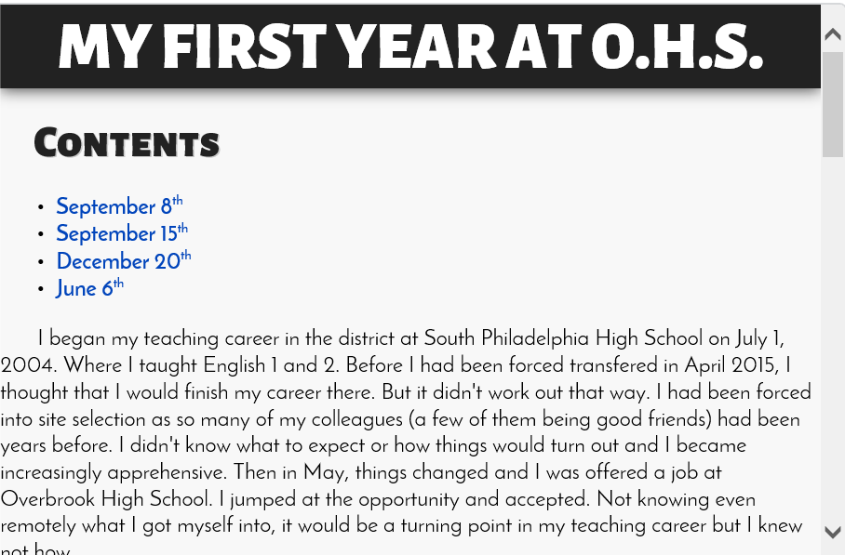
Sample Project Screenshots

Slide 41
Do Now: October 30 and 31, 2017
Identify at least 3 errors in the following code snippet:
<body>
<div id = “title><h1>Mr. Verlin’s Blog
<style>
</body>

Slide 42
Do Now: November 1 and 2, 2017
Identify at least 3 errors in the following code snippet:
<style>
%h2 {
color: red
<body>
</style>

Slide 43
Do Now: November 3, 2017
Log in to Khan Academy and load your blog project.

Slide 44
October 26-November 9, 2017: Blog Project
Objective: the students will be able to type 4 5-sentence paragraphs, change the font families, styles and sizes on a web page in order to create a blog consisting of approx. 100 lines of code (due Nov. 18 for 50 project points).
Direct Instruction: Sample Blog Project Requirements
Must contain a banner
Must contain at least 4 blog posts
a. entry title
b. entry subtitle (post date)
c. entry (5 sentence min.)
3. Must have a table of contents which links the posts
4. Must have 3 CSS rules
5. Must use at least 4 different CSS properties which start with font-
6. Must not have any errors

